Slide 1

Welcome to ProboTalent
Improve Candidate Credibility with Digital Reference Checks

Slide 2

PEERS™ | Innovative Agile Recruitment Tool
In the current recruitment climate, the urgency to adapt has never been greater.
Challenges such as mismatches in required skills, underrepresentation in workforce diversity, increasing incidences of candidate ghosting, attrition, and deception are becoming more prevalent.
These issues underscore an imperative need to develop and implement innovative and agile recruitment strategies that are inclusive and address these growing concerns.

Slide 3
Drawbacks and Challenges of Traditional Reference Checks
Drawbacks
Candidate Ghosting and Drop-off
Increasing Recruitment Costs
Inaccurate Candidate Data
Lack of Diversity in Talent Pool
Lengthy Hiring Processes
Difficulty in Identifying Fraudulent Information
Challenges
Hidden Candidate Potential
Trusting Candidates and Resumes
Skills Mismatch
Verification Process Time Constraints
Talent Shortages
Technological Disruption

Slide 4
Why ProboTalent and PEERS™
Enhanced Verified Candidate Profiles
Gain in-depth insights with verified data from references, recommendations, endorsements, and job verifications, aggregated from multiple reliable sources.
Uncover Hidden Insights
Discover concealed soft skills, potential, and cultural fit with verified trusted candidate data that reveal talent potential overlooked by resumes and mitigate resume inaccuracies.
Risk and Fraud Mitigation
Enhance diversity and objectivity with validated data-backed insights, while reducing the risk of false information and fraudulent references.
Streamlined Hiring Process
Achieve quicker turnaround times while accessing reliable candidate information, conserving resources, and minimizing candidate drop-off and ghosting.
Viral Coefficient Expanded Talent Reach
Respondents can opt-in to join the passive candidate pool, amplifying the viral coefficient. Access new talent through multiple avenues beyond just references.
Embrace Technological Advancements
Utilizing technological advancements for efficient and adaptable recruitment solutions.

Slide 5



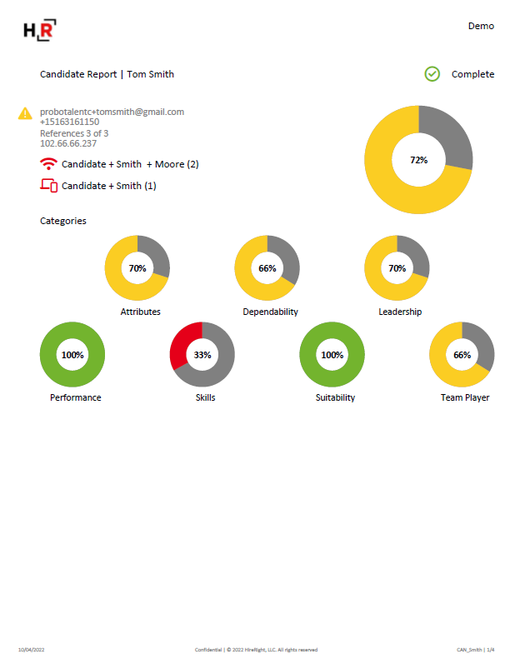
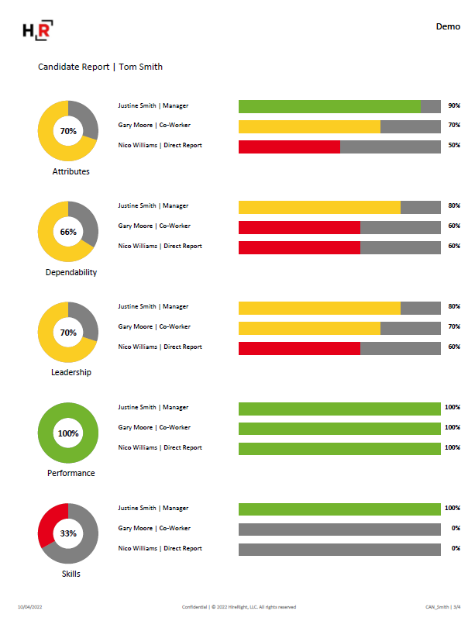
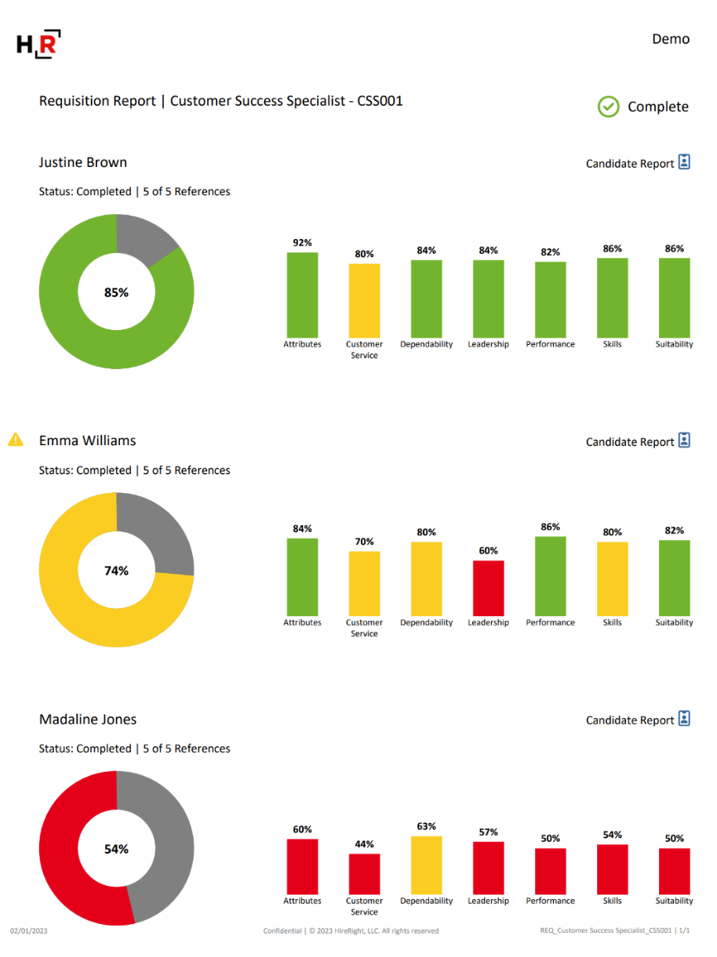





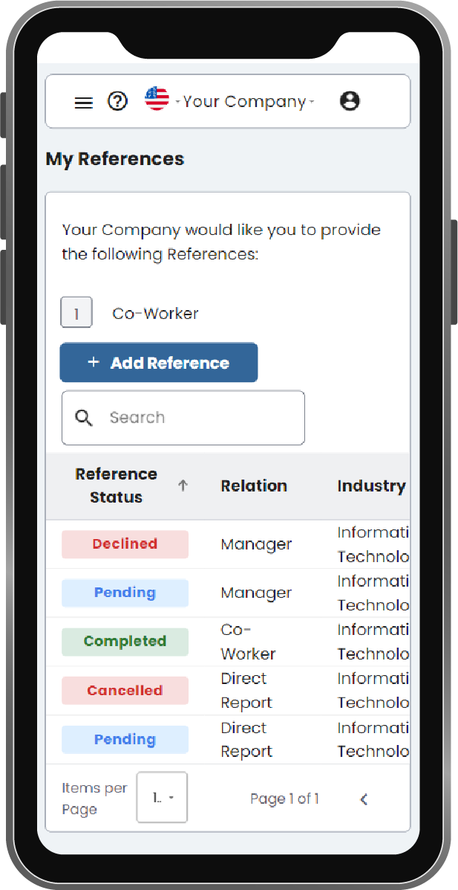

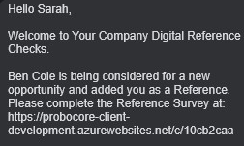

Transform your Process while Developing a New Talent Pool
Recruiter initiates Reference Check with the number of References by type
Recruiter receives Reports and Data Analytics
Recruiter
Candidate is invited to sign up via email and SMS and creates account
Candidate
Candidate provides all References information from any device
Industry averages show that 30% of References Opt-In becoming New Passive Candidates
References
New Talent Pool
References receive a secure link via email and SMS and completes Survey
References are invited to Opt-in to be considered for new job opportunities

Slide 6
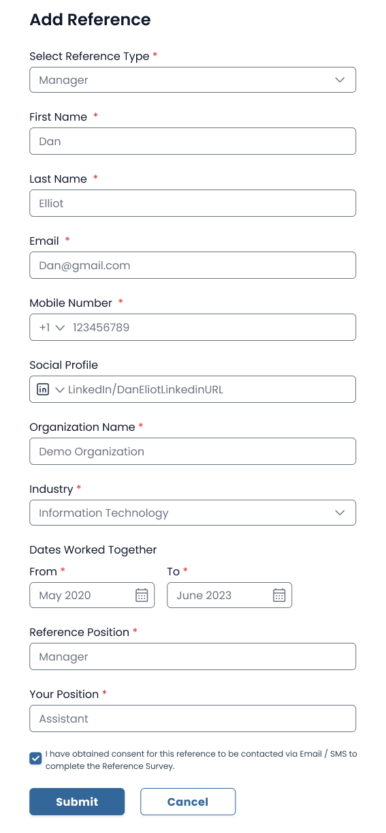
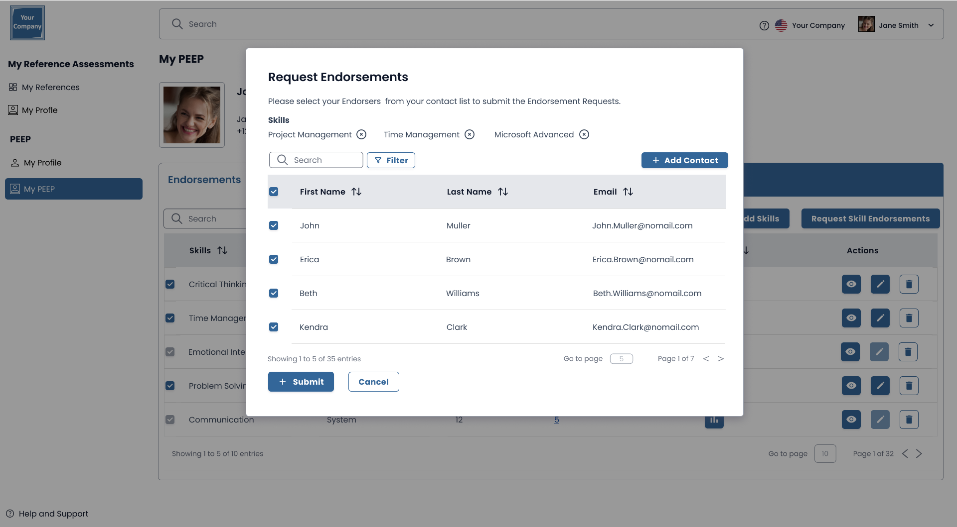
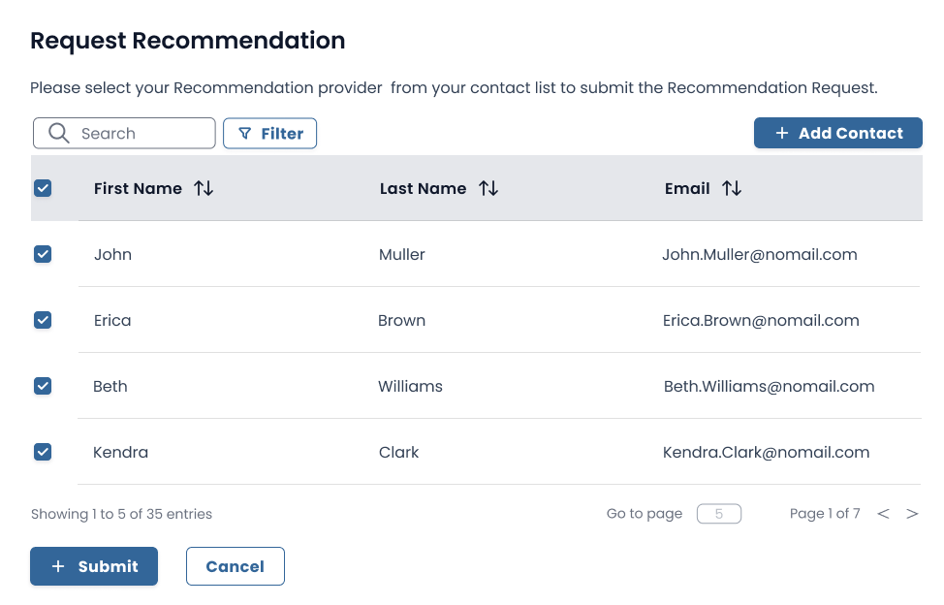
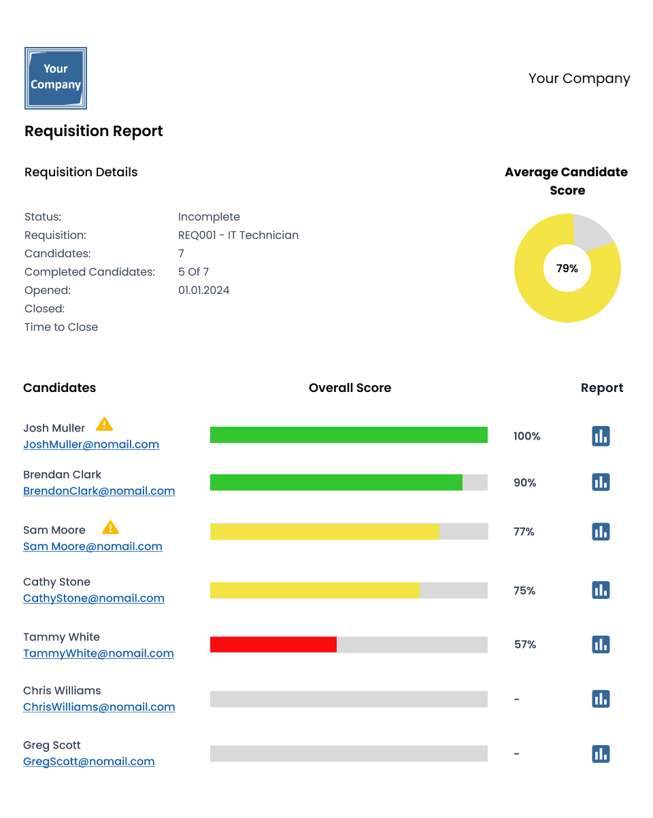
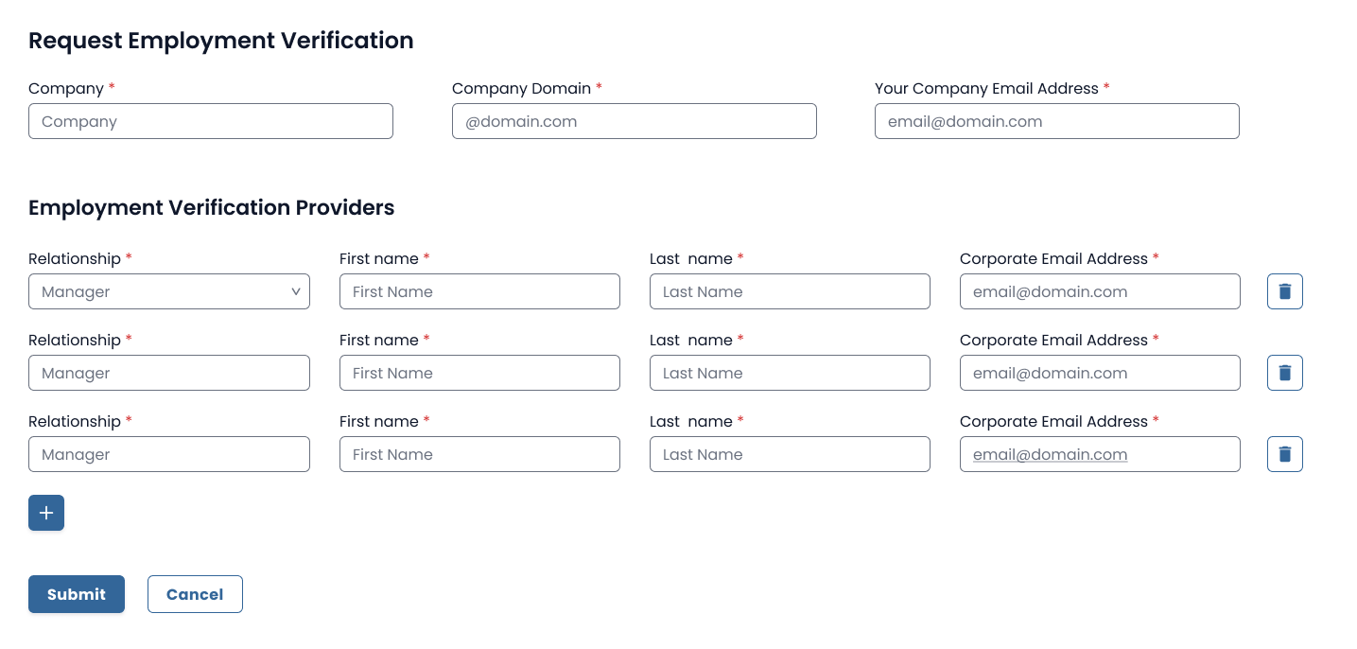
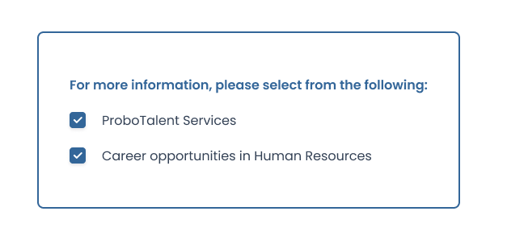
Solutions
ProboTalent Solutions
Digital Reference Checks
Enhanced Candidate Credibility with PEERS™
  Data is verified and compared with other respondents to provide insightful trusted Candidate Profiles through:
  References
  Skill Endorsements
  Employment Verifications
  Recommendations
Candidate PEERS™ activity has a very High Viral Coefficient creating many New Passive Candidates, adding to your talent pool.
PEERS™ Feedback Providers are verified through
  Domain, IP and Device Validation

Slide 7

High Viral Coefficient with Expanded Talent Reach
Expanded Talent Reach
Based on industry averages over 30 % of References will opt-in and become Passive Candidates
ProboTalent reaches further than just references, providing this opportunity to Endorsement, Recommendation and Job Verification Providers to also opt-in.
Respondent
Candidate

Slide 8

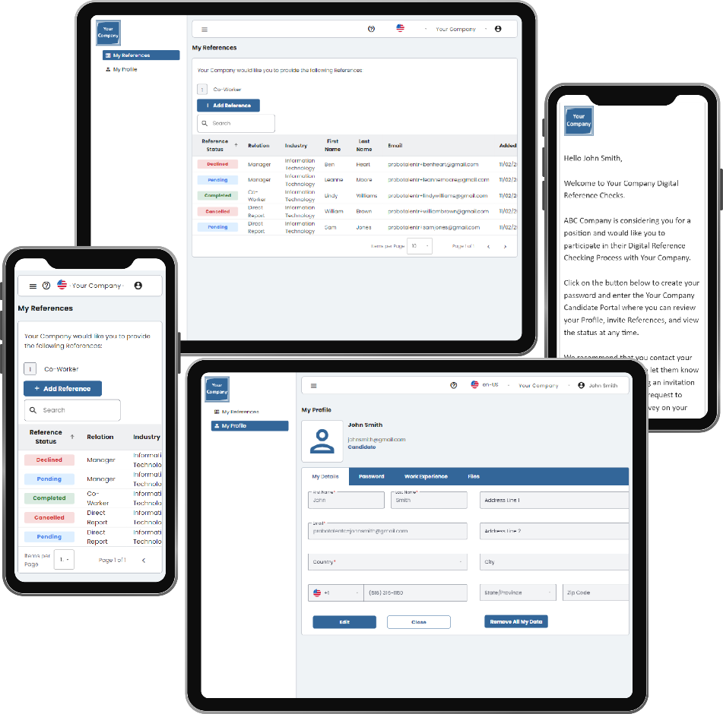
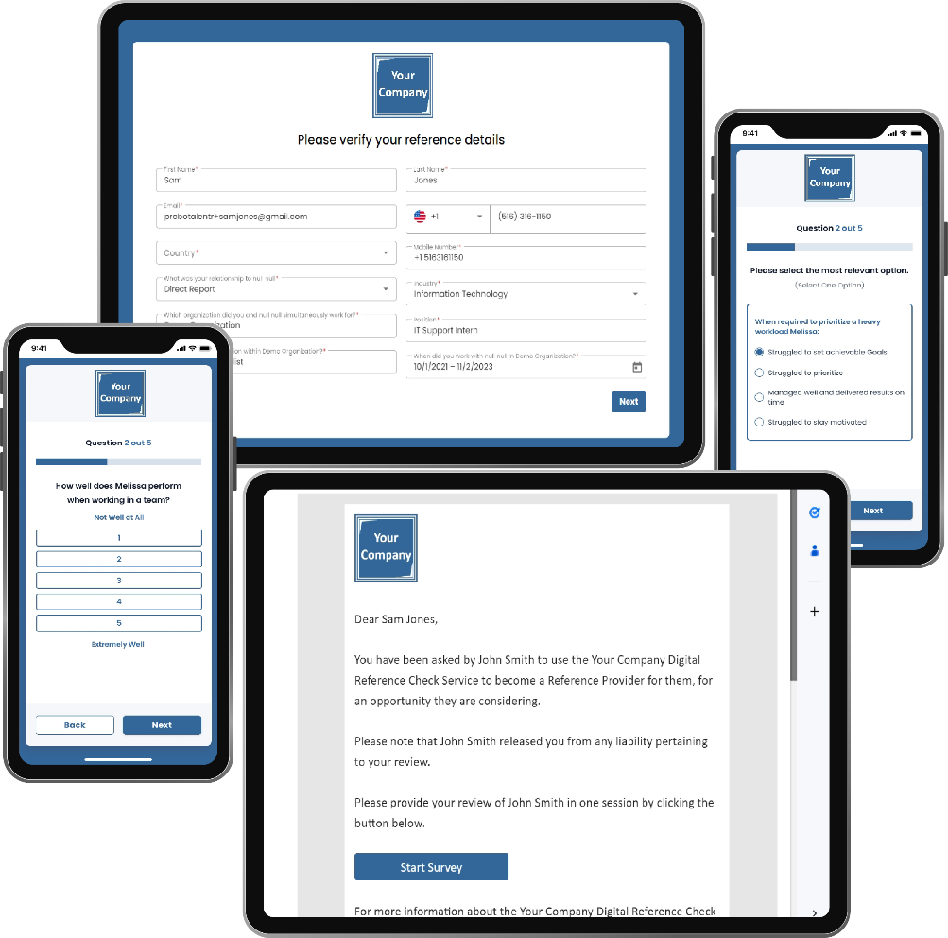
Responsive Mobile Friendly Platform
Candidates
References

Slide 9




Introduce a Highly Differentiated New Product Line as a Differentiator
Flexible Pricing Model
100% White Label Offering, No “Powered by ProboTalent” disclosure
ProboTalent API provides Robust integration into partner products
All agreements are embedded into workflow
Fraud Detection controls for IP Address and Device
Microsoft Azure Cloud Services Scalability and Security
User Guides and Online Help contained in application
GDPR Compliant
WCAG 2.1 AA Compliant (Web Content Accessibility Guidelines)
Candidate
Credibility

Slide 10


ProboTalent Founders | Extensive HR Technology Experience
Anthony Petraco
ProboTalent LLC
Co-Founder | Chief Executive Officer
Bill Filip
ProboTalent LLC
Co-Founder | Board Member
ProboTalent, LLC | Founder, Chief Executive Officer | 4 Years
Digital Reference Checks and Candidate Credibility Platform
Valiant Payroll | Founder and Chief Executive Officer | 23 Years
Payroll, TLM and HRIS focused on Large Hourly Workforces
2 Million employees serviced | $ 6 Billion in Annual Payroll
Federal, 50 States, Local, Labor, Wage and Hour Compliance
$ 57 Million Majority Recap in 2016, Retired as CEO in 2019
$ 150 Million K1 Investment Management in 2019
OCS Group | Partner, Chief Operating Officer | 8 Years
Staffing and Security Guard Firm | Grew business from 150 to 2,500 Employees and sold to Rentokil, United Kingdom
Delancey Street Partners | Founder and Managing Partner | 12 Years
Present – Managing Partner with a particular strength in all areas of the Human Capital Management (HCM) sector including service models (staffing, professional services, RPO, executive search), outsourcing models (HRO/BPO) and SaaS technology models (all talent acquisition areas, talent management, payroll, PEO, EOR, assessment and background screening.)
R.W. Baird Venture Partners | Co-Founder, Partner, Head of Business & Technology Services Investing | 12 Years
Bill has participated on the Boards of many Leading HCM Technology Companies including: GR8 People, Paychoice Payroll, Cielo Talent, SnagAJob.com, HireRight, Patina Solutions, Smartime, Driving Dynamics, Inside Track and HR Tech Alliances.
https://www.linkedin.com/in/anthonypetraco/
https://www.linkedin.com/in/bill-filip-805b145/

Slide 11






RPO Strategic Partner Testimonial
"As a leading recruitment process outsourcing firm, our primary objective is to redefine hiring practices for our esteemed clients. Through ProboTalent, we have successfully streamlined the reference checking process, significantly reducing time while providing invaluable insights that enhance our clients' confidence in their hiring decisions.
"In an age where verifying candidates' authenticity amidst the proliferation of generative AI presents formidable obstacles, ProboTalent stands out as a reliable solution. With its digital capabilities, ProboTalent ensures the credibility of our candidates through independent third-party validation.
"Furthermore, ProboTalent facilitates access to a pool of passive candidates, enriching our clients' talent pipelines with top-tier individuals sourced directly from their references."
Senior Recruiting Partner
Leading, Award Winning RPO

Slide 12

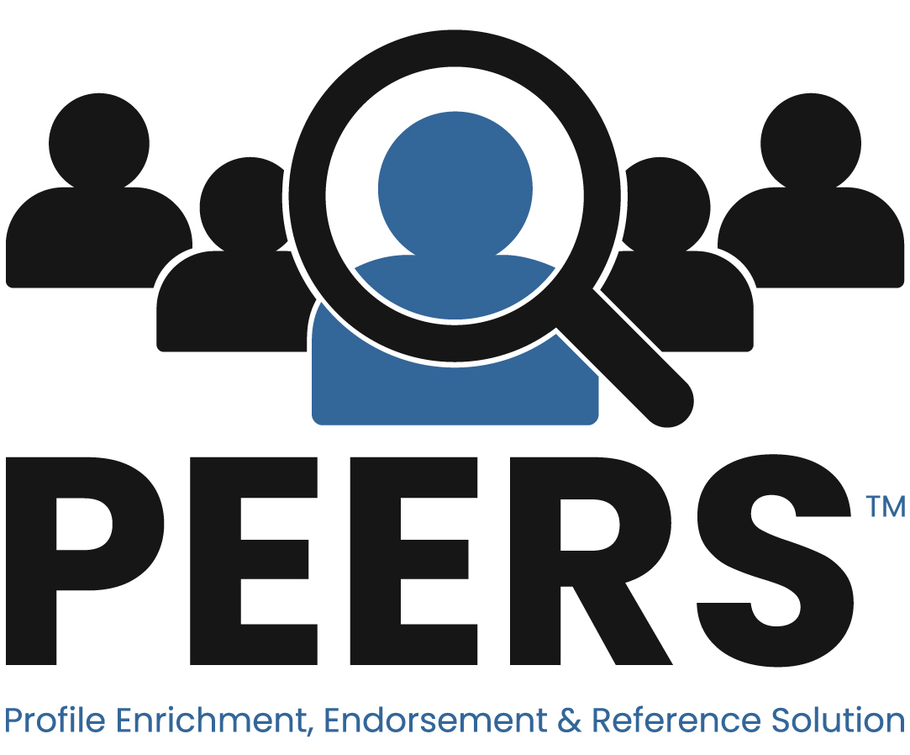
Perfect Addition to your Recruitment Technology Stack
Video Interviewing
Artificial Intelligence
Talent Communities
Candidate Relationship Management
Data and Analytics
Applicant Tracking Systems
Background Checks
Communication Tool
Recruitment Marketing Platforms
Assessments
Onboarding Software
Collaboration Tool

Slide 13






Contact Us
Anthony Petraco
Founder | Chief Executive Officer
+ 1 516 – 508 -3715
+ 1 631 – 479 - 7911
+ 1 833 – Probo HR
anthony@probotalent.com
www.probotalent.com
www.probotalent.com

